Slide 1

Static Analysis and Code Optimization Techniques in Compiler Design
This presentation explores the crucial roles of static analysis and optimization in modern compiler design, aiming to enhance code performance and efficiency.

Slide 2
Introduction to Compiler Design
Compilers act as translators, converting high-level programming languages into machine-readable code.
1
Lexical Analysis
Tokenizes the input code, breaking it down into meaningful units.
2
Syntax Analysis
Parses the token stream, verifying the code's grammatical correctness.
3
Semantic Analysis
Ensures the code's meaning is consistent and valid, checking for type errors.
4
Intermediate Code Generation
Translates the source code into an intermediate representation, optimizing for efficiency.
5
Code Optimization
Improves the generated code's performance, making it faster and more efficient.
6
Code Generation
Produces the final machine code that can be executed by the target processor.

Slide 3
Static Analysis Techniques
Static analysis techniques analyze source code without actually executing it, uncovering potential issues.
Type Checking
Data Flow Analysis
Control Flow Analysis
Verifies that variables and expressions are used with the correct data types, preventing errors.
Tracks the flow of data throughout the code, identifying potential issues like unused variables or undefined values.
Examines the flow of control in the program, identifying potential issues like unreachable code or infinite loops.

Slide 4
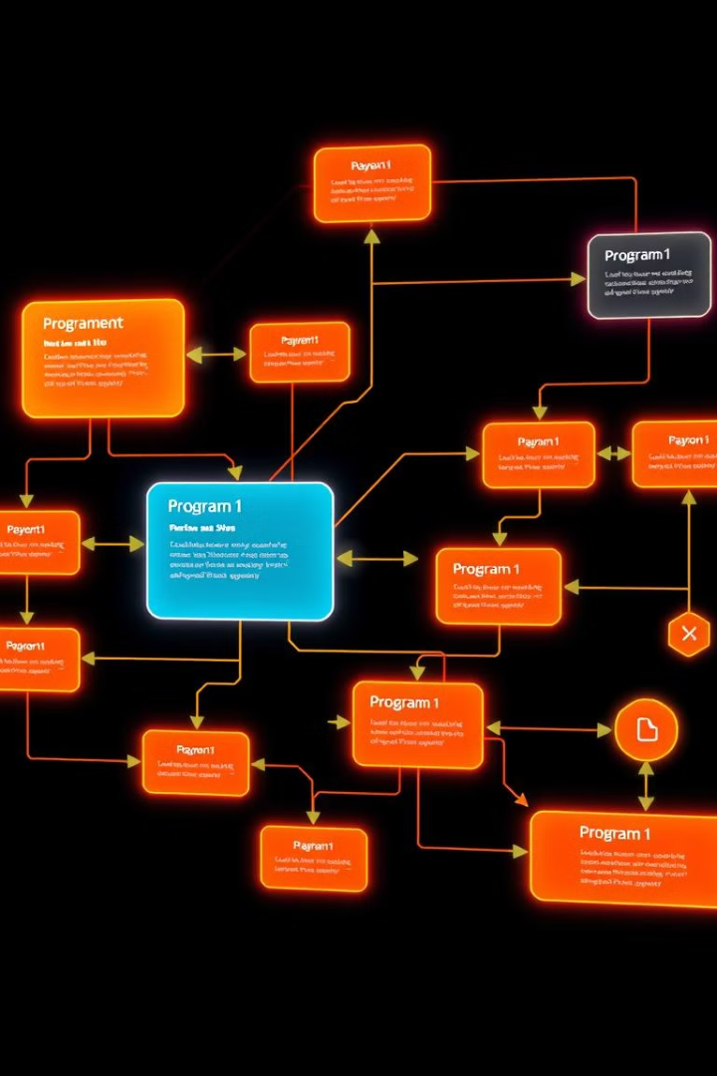



Control Flow Analysis
Control flow analysis determines how a program's execution path progresses, identifying potentially problematic areas.
Dominator Analysis
Identifies nodes that must be executed before other nodes in the program.
Post Dominator Analysis
Identifies nodes that must be executed after other nodes in the program.
Loop Analysis
Identifies and characterizes loops, enabling optimization techniques like loop unrolling.

Slide 5

Data Flow Analysis
Data flow analysis tracks the flow of data within a program, identifying potential issues like unused variables or undefined values.
Reaching Definitions
Identifies the definitions of variables that can be used at each point in the program.
Live Variable Analysis
Determines which variables are potentially used after a given program point.
Available Expressions
Tracks expressions that have already been computed and can be reused.

Slide 6

Optimization Techniques
Optimization techniques aim to improve the performance of generated code, reducing execution time and resource consumption.
1
Constant Folding
2
Dead Code Elimination
Evaluates constant expressions at compile time, reducing runtime overhead.
Removes unreachable or unused code, streamlining the program.
3
Loop Unrolling
4
Strength Reduction
Repeats the loop body multiple times, potentially reducing overhead.
Replaces expensive operations with equivalent but less costly operations.

Slide 7




Peephole Optimization
Peephole optimization focuses on small, localized code sequences, improving efficiency by simplifying or rearranging instructions.
Strength Reduction
Replaces expensive operations with equivalent but less costly operations.
Jump Optimization
Simplifies jump instructions to reduce the number of instructions executed.
Dead Code Elimination
Removes unreachable or unused code, streamlining the program.

Slide 8

Conclusion and Future Directions
Static analysis and optimization techniques play crucial roles in modern compiler design, ensuring efficient and effective code execution.
Automated Code Analysis
Cross-Platform Optimization
Leveraging AI and machine learning for more sophisticated code analysis and optimization.
Developing optimization techniques that cater to the specific characteristics of different target platforms.
Energy Efficiency
Focusing on energy-conscious optimization strategies to reduce power consumption in resource-constrained environments.

